Slide 1
Adapting Pretrained Models for Machine Translation
Aditya Kurniawan

Slide 2
motivations
Pre-trained Models
Fine-tuning with Adapters
We want to benefit from the knowledge that was gathered in the pre-trained models
We want to benefit from the potential performance boost from pre-trained models
More stable and robust than naïve fine-tuning
Improves efficiency of fine-tuning large pre-trained models

Slide 3
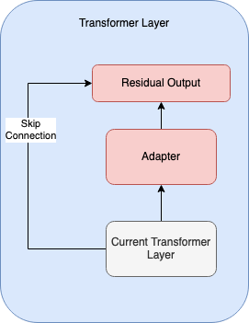
Adapter Module (Pfeiffer et al. 2020)

Slide 4
goals
QUALITY OF PRE-TRAINED MODELS
Investigate the quality of pre-trained models when fine-tuned with adapters
EFFECTIVENESS OF ADAPTERS
Investigate the importance of adapters in encoder or decoder
Investigate the importance of the actual weights in the pre-trained models when fine-tuned with adapters
Investigate techniques to reduce the original pre-trained BERT model size when fine-tuned with adapters

Slide 5

methodology

Slide 6
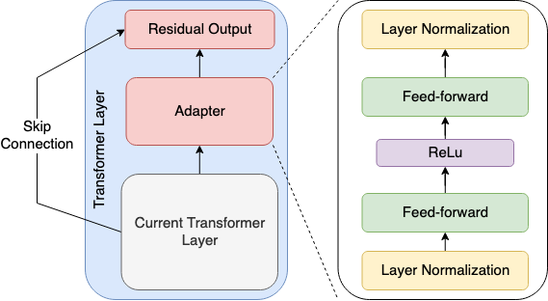
Adapter Module (Pfeiffer et al. 2020)
Fine-tuning Process
Seed model is firstly pre-trained on source domain data / source task.
During fine-tuning stage only adapter parameters are trained.
Bottleneck layer with reduction ratio = R

Slide 7
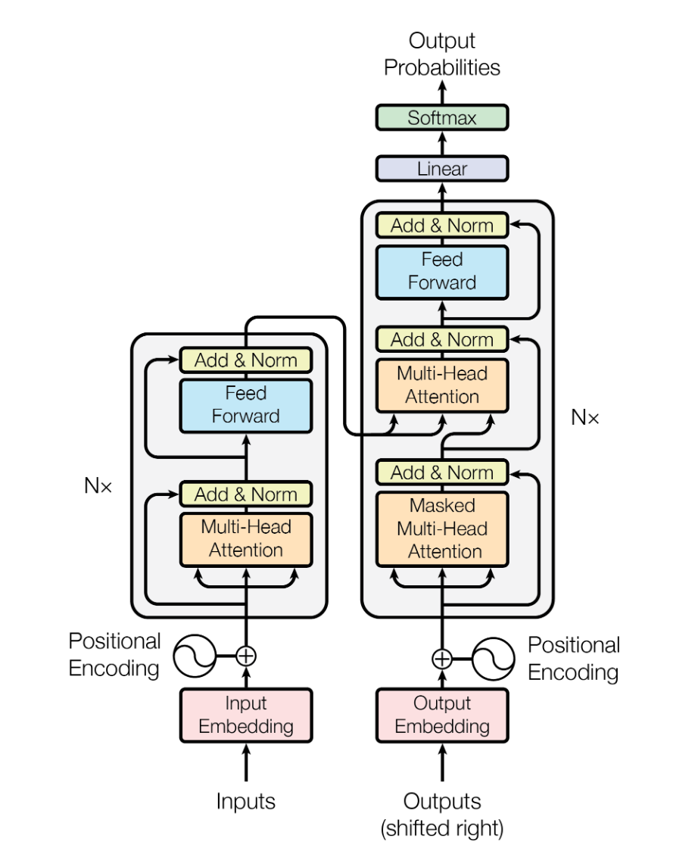
Transformer (Vaswani et al. 2017)
Transformer architecture diagram from Vaswani et al. 2017

Slide 8
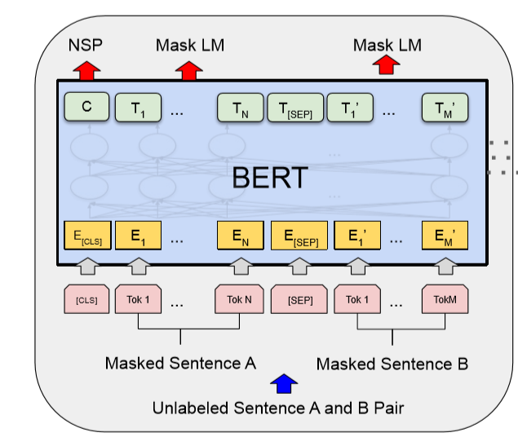
BERT (Devlin et al. 2018)
What we used from BERT?:
Pre-trained weights
Hyperparameters
Number of layers
Attention head numbers
etc
BERT diagram from Devlin et al. 2018

Slide 9
Tasks and dataset
 | LANGUAGE MODEL (PRE-TRAINING) |  |  | MACHINE TRANSLATION (BASELINE EXP 1) |  |  | MACHINE TRANSLATION (FINE-TUNING)
 | TRAIN | DEV | TEST | TRAIN | DEV | TEST | TRAIN | DEV | TEST
IWSLT 2014 | V | V | V | V | V | V | V | V | V
IWSLT 2014 + WMT 2019 (500K) | V | X | X | V | X | X | X | X | X
IWSLT 2014 + WMT 2019 (2M) | V | X | X | V | X | X | X | X | X

Slide 10
Adapters in machine translation

Slide 11
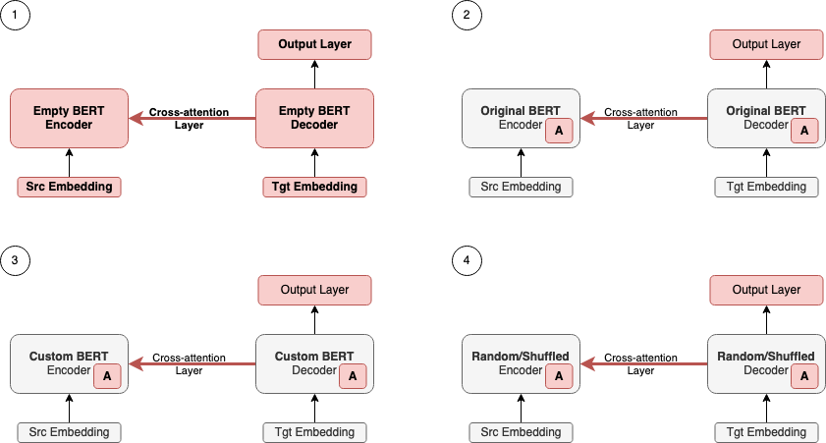


Experiments FOR GOAL NO. 1
= Adapters
Baseline
BERT + Adapters
Custom BERT with different volumes of pre-training data
Random/Shuffled pre-trained
Notes:
Don’t forget the reduction ratio experiments

Slide 12
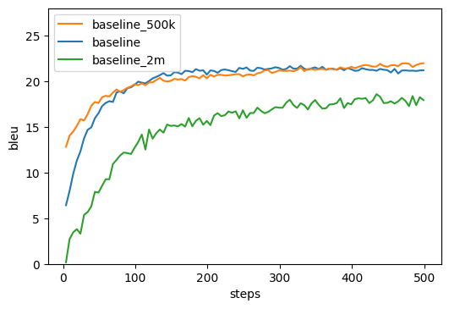
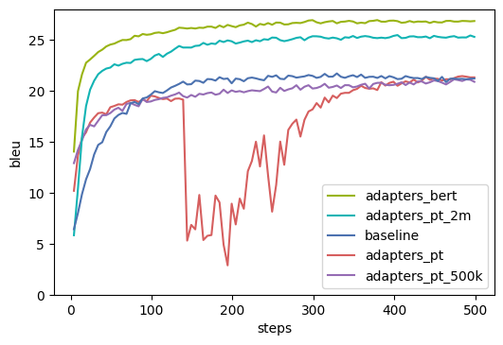
Adding more data for training
No adapters
With adapters
Adding more data such as baseline_2m (millions) when training from scratch without adapters doesn't always help
In contrast with the baseline, when adding more data to the pre-training we can see benefit where the performance of 2m exceeds the 500k

Slide 13
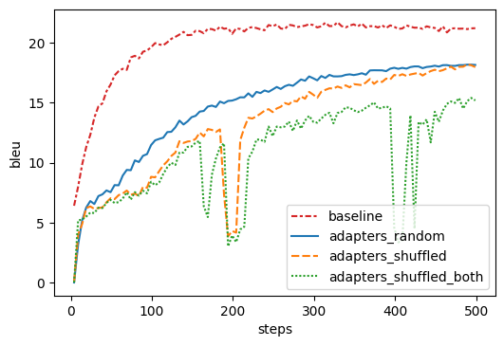
Random & shuffled pre-trained models
The performance when using pre-trained models with inferior quality degrades compared to the baseline
Shuffled has more erratic performance compared to the random due to different weights distribution in the model

Slide 14
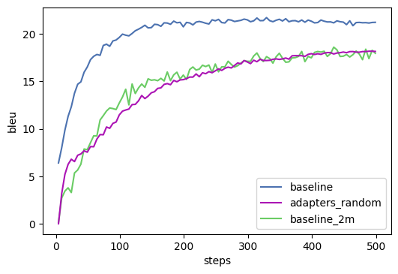
Random pre-trained vs baseline
The performance of the random pre-trained is actually not that bad if compared to the baseline that trained with 2m (millions) sentence pairs

Slide 15
Adapters Effectiveness in Machine Translation

Slide 16
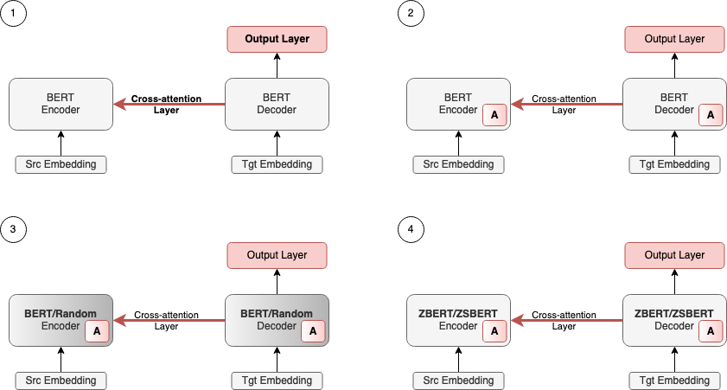
Experiments FOR GOALS NO. 2, 3, AND 4
= Adapters ablated on
encoder or decoder
Baseline
Adapters Position
Random pre-trained
Pre-trained model size reduction
Notes:
Don’t forget the reduction ratio experiments

Slide 17
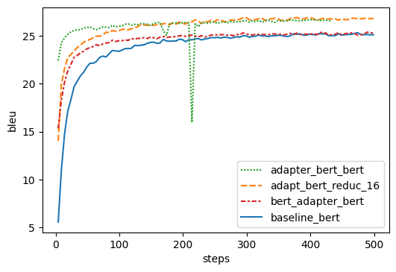
Adapters position (Encoder vs Decoder)
Green vs Orange line: removing adapters on the decoder learns faster in the beginning but has no impact on the final performance
Red: removing adapters on the encoder reduces the performance to the baseline level (blue line)

Slide 18
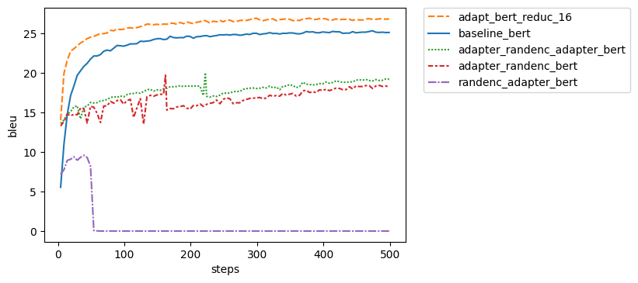
Randomly set weights on encoder
Using random weights on the encoder reduces the performance significantly
The problem exacerbates when the adapter is removed from the encoder (caused by gradient explosion from the cross-attention layer)

Slide 19
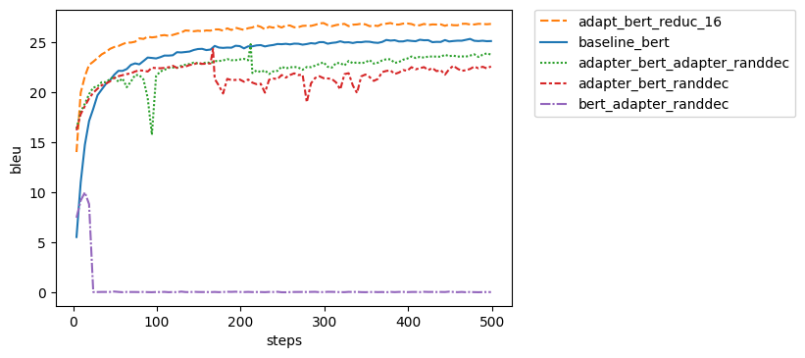
Randomly set weights on decoder
Using random weights on the decoder has better performance than in the encoder
The drops when the adapter is removed from the encoder
Using random set weights on encoder results in the same behaviour but lower performance

Slide 20
Using Fewer Weights: ZBERT and ZSBERT
2 | 0 | 3
4 | 0 | 10
7 | 0 | 9
W’ =
Original BERT
zbert
2 | 1 | 3
4 | 5 | 10
7 | 8 | 9
W =
2 | 3
4 | 10
7 | 9
zsbert
W’ =
Rows = Neurons
Columns = Features

Slide 21
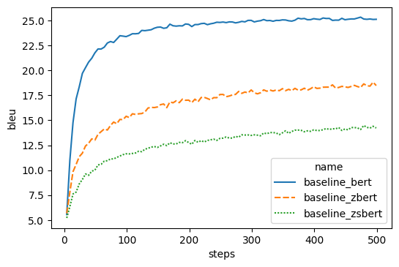
Baseline
Removing BERT weights arbitrarily clearly has a detrimental impact to the model’s performance

Slide 22
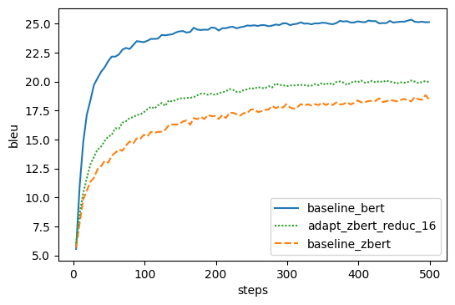
Bert size reduction (zbert)
Adapters help but not much to recover the performance back to baseline

Slide 23
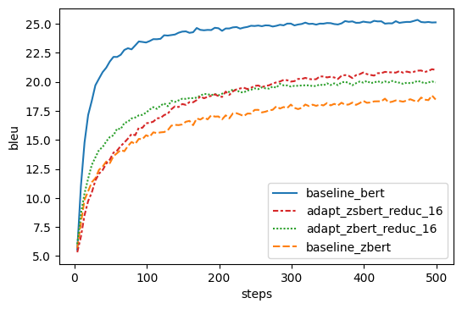
Bert size reduction (ZSBERT)
Adapters help but not much to recover the performance back to baseline
Eventually the adapters in ZSBERT manage to outperform ZBERT

Slide 24
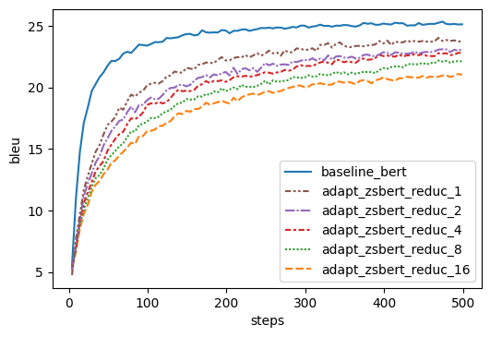
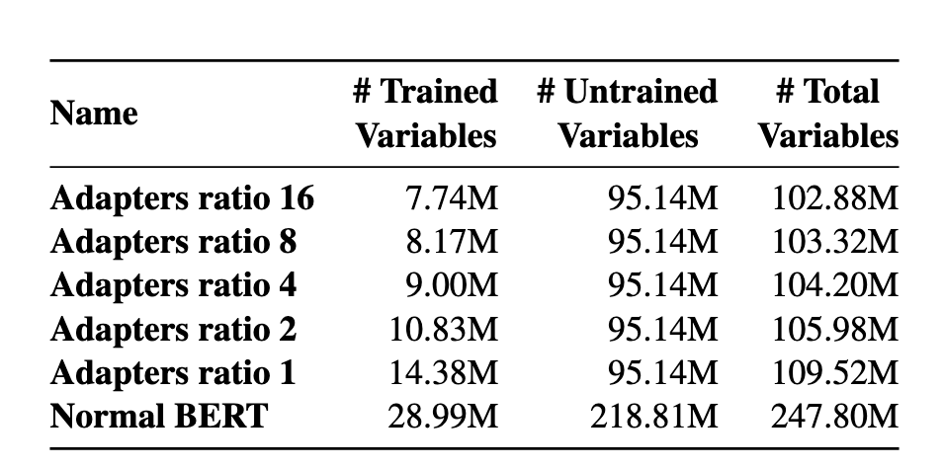
Bert size reduction with smaller reduction ratio
Reducing the reduction ratio helps to recover the performance
Even though more weights are added, the total variables are still way fewer than the original BERT

Slide 25
Conclusion
Investigate the quality of pre-trained models when fine-tuned with adapters
Incorporating more data in pre-training helps the final performance after fine-tuning [compared to training the model from scratch]
Fine-tuning adapters with random pre-trained models achieves on-par performance [compared to training the models from scratch with larger data]

Slide 26
Conclusion
Investigate the importance of adapters in encoder or decoder
Adapters on the encoder side are more important than in the decoder
Investigate the importance of pre-trained weights in the pre-trained models when fine-tuned with adapters
The actual pre-trained weights are more important in the encoder. Interestingly, when the adapters were injected only to the decoder, the performance dropped to zero.
Investigate techniques to reduce the original pre-trained BERT weights size with adapters
ZSBERT can match the performance of the baseline when the reduction ratio is not big.

Slide 27
Q&A

Slide 28
what did I learn?
Manage to complete 8 different types of experiments
Adapting code from huggingface for the experiments (both LM and MT)
Understanding the inside implementation of transformer for debugging
Learn to integrate the huggingface with WANDB for better training monitoring

Slide 29
Question
The student suggests creating three different datasets to study how much the additional data affect pre-training performance: IWSLT, IWSLT+WMT500k and IWSLT+WMT2M. Is there a reason for mixing the in-domain IWSLT data with general-domain WMT dataset? Did the student consider studying the data volume effects strictly in a general domain settings (or in-domain, if there was a larger volume of IWSLT data available)?

Slide 30
answer
No adapters
With adapters
Adding more data when training from scratch without adapters doesn't always help
In contrast with the baseline, when adding more data to the pre-training we can see benefit where the performance of 2m exceeds the 500k

Slide 31
Question
In the parameter shuffling, zeroing and removal experiments, the student describes the operations with respect to rows and columns of the parameter matrices. This description is too vague - depending on the order of tensors in the operation (y = W x vs y = xW , x being input tensor and W parameter matrix), row/column modifications have different implications. A description with respect to the output tensor (y) would probably be more helpful. In case of zeroing, does the operation imply zeroing values in certain positions of the resulting tensor y (in the example above) or just changing the values? In case of zeroing the embedding/output matrices, does the student zero whole vocabulary entries or just specific positions in every embedding vector?

Slide 32
Question
The student shows that the model with adapters can partially “recover” even when the rest of the model parameters is randomly initialized and not updated. This is later further investigated by zeroing/removing half of the parameter values from the fixed part of Transformer. (1) Did the student consider also completely zeroing the whole fixed part of the Transformer (excluding input embeddings and output matrix) to see the sole contribution of adapters (and cross-attention layer) to translation quality (since the information can still flow through the identity function in residual connections)? (2) In addition, is there a reason for random removal/zeroing of parameters instead of a structured approach based on a metric (i.e. “importance” used in neural network pruning literature)? In my opinion, the introduction of additional stochasticity can lead to more obfuscation and consequently, harder interpretability of the results. Trying to remove only a half of the parameters seems to not give much insight into the studied problem. Additional experiments with different portions of network being zeroed (even with stochastic removal) would help to see whether some pattern arises with respect to the weight zeroing.

Slide 33
Question
The student mentions that the lower performance of zsbert (compared to zbert) is a result of breaking the pretrained layer normalization. Did the student consider unfreezing and fine-tuning the layer-norm trainable parameters to readjust to the dimension reduction?

Slide 34
Question
In the conclusion the student claims “We further show that even with random fixed weights in the main part of the model, the adapters and cross-attention can recover and achieve performance similar to one of the baseline models (the baseline 2M model).”, however, I would argue that the adapter model benefits from being trained on in-domain IWSLT data (the comparable baseline model used IWSLT+WMT dataset). Can the student refute this argument?

Slide 35
Question
In the experiments with only encoder or decoder initialized with pre-trained BERT model, it would make sense to unfreeze the randomly initialized part of the model (that is, only the pre-trained BERT parameters are frozen) since it should lead to better overall results. Is there a reason why these experiments were excluded by the student?

Slide 36
The student suggests creating three different datasets to study how much the additional data affect pre-training performance: IWSLT, IWSLT+WMT500k and IWSLT+WMT2M. Is there a reason for mixing the in-domain IWSLT data with general-domain WMT dataset? Did the student consider studying the data volume effects strictly in a general domain settings (or in-domain, if there was a larger volume of IWSLT data available)?
It is intentional that we bring out-of-domain data as a part of our training process. We would like to see the model’s reaction to the difference in the data distribution. We can see from the baseline that when we train with the mixed data where the amount of out-of-domain data overwhelm the in-domain data (2M), the model face difficulties and may need more time to eventually reach similar performance than the other baselines. If we assume the same difficulties exist during the pre-training then it is possible that the adapters can help to efficiently leverage the information and eventually able to help in gaining better performance during fine-tuning.

Slide 37
In the parameter shuffling, zeroing and removal experiments, the student describes the operations with respect to rows and columns of the parameter matrices. This description is too vague - depending on the order of tensors in the operation (y = W x vs y = xW , x being input tensor and W parameter matrix), row/column modifications have different implications. A description with respect to the output tensor (y) would probably be more helpful. In case of zeroing, does the operation imply zeroing values in certain positions of the resulting tensor y (in the example above) or just changing the values? In case of zeroing the embedding/output matrices, does the student zero whole vocabulary entries or just specific positions in every embedding vector?
In the case of zeroing, the operation modifies the original BERT matrices in the column-wise. Meaning that we modify the features on every neuron in a single layer. The same case also applied in the embedding vector, we do not remove/add vocabulary entries.

Slide 38
The student shows that the model with adapters can partially “recover” even when the rest of the model parameters is randomly initialized and not updated. This is later further investigated by zeroing/removing half of the parameter values from the fixed part of Transformer. (1) Did the student consider also completely zeroing the whole fixed part of the Transformer (excluding input embeddings and output matrix) to see the sole contribution of adapters (and cross-attention layer) to translation quality (since the information can still flow through the identity function in residual connections)? (2) In addition, is there a reason for random removal/zeroing of parameters instead of a structured approach based on a metric (i.e. “importance” used in neural network pruning literature)? In my opinion, the introduction of additional stochasticity can lead to more obfuscation and consequently, harder interpretability of the results. Trying to remove only a half of the parameters seems to not give much insight into the studied problem. Additional experiments with different portions of network being zeroed (even with stochastic removal) would help to see whether some pattern arises with respect to the weight zeroing.
(1) We did not consider completely zeroing the whole fixed part of the Transformer as we are not sure if that would be “recoverable” even with adapters, since all the weights in the Transformer then become identical and very difficult to distinguish which part of the network is beneficial to “tune”
(2) We do not consider structured approach that is mentioned as the purpose of using that is different from the goal in this thesis. Taking the “importance pruning” as an example, I assume that this to get the best weights in BERT and then further fine-tune it to even better the performance. While in this thesis, we want to understand the capability of the adapters themselves when faced with ”difficult” pre-trained models

Slide 39
The student mentions that the lower performance of zsbert (compared to zbert) is a result of breaking the pretrained layer normalization. Did the student consider unfreezing and fine-tuning the layer-norm trainable parameters to readjust to the dimension reduction?
We did not consider unfreezing and fine-tuning the layer-norm as we want to isolate the experiments by not modifying the original network. We consider this as a further “challenge” for the adapters to recover damaged pre-trained models while also trying to achieve the most optimal results.

Slide 40
In the conclusion the student claims “We further show that even with random fixed weights in the main part of the model, the adapters and cross-attention can recover and achieve performance similar to one of the baseline models (the baseline 2M model).”, however, I would argue that the adapter model benefits from being trained on in-domain IWSLT data (the comparable baseline model used IWSLT+WMT dataset). Can the student refute this argument?
It is correct that by fine-tuning the random on in-domain IWSLT data we can achieve similar performance as the baseline 2M model. I would like to propose interpreting the result from different perspective: By showing that fine-tuning adapters with a complete random pre-trained model could achieve a decent performance, there might be some information within the network (other than the weights) that the adapters can use. We can use this as a benchmark to explore other types of pre-trained models that is simpler to create. For example, can we derive an architecture that is less complex than BERT but easier for the adapters to adapt? Maybe instead of tuning the weights of the model, we are now tuning the architecture (or flow of information within the network). That might be cheaper as we are not updating hundreds of millions/billions of parameters.

Slide 41
In the experiments with only encoder or decoder initialized with pre-trained BERT model, it would make sense to unfreeze the randomly initialized part of the model (that is, only the pre-trained BERT parameters are frozen) since it should lead to better overall results. Is there a reason why these experiments were excluded by the student?
I agree that it is make sense to unfreeze that part to achieve better performance. However, our goal is to see the behaviour of the adapters and the contribution they bring when one of the components is defected. Therefore, we limit the scope of our experiments by not modifying the pre-trained model.

Slide 42
Extra slides

